Slide 1
Time complexity, and
C++
Standard Template Libraries
(STLs)
Aman Kumar Gupta
Bhushan Khanale

Slide 2
Time Complexity
> One of the most important part of competitive programming.
> You need to solve a particular problem in the expected time complexity.
> We’ll start from basics but it is highly recommended you should go through CLRS book once for the time complexity part.

Slide 3
Time Complexity
> What is it?
It’s simply a measure of what order of time your program takes to complete a run.
We do have best case and worst case time complexities depending upon the input but we only consider the worst case (most of the times).
> Calculation:
There are theorems but we won’t dive into them since you can read them yourselves from the book.
Instead we will use simple code templates to understand time complexity.

Slide 4
Example 1
for( i = 0 to n ) {
for( j = 0 to n ) {
// You do some constant time operations O(1)
}
}
Time Complexity: O(n ^ 2)

Slide 5
Example 2
for( i = 0 to n ) {
for( j = i to n ) {
// You do some constant time operations O(1)
}
}
Time Complexity: O(n ^ 2)

Slide 6
Example 3
i = n;
while ( i != 0 ) {
i = i / 2;
}
Time Complexity: O(log n)

Slide 7
Guess the time complexity before solving
> Remember for any online judge in 1 sec it can perform ~10 ^ 7 operations.
> Hence for n <= 10 ^ 7, your code should be in terms of O(n) or O(n log n)*
The time complexity may not be straight forwards and also may contain multiple variables but your biggest order should be satisfying the constraints for the code to work.
> The constraints provide you all the info to calculate the expected time complexity.

Slide 8
Optimization
> Sometimes it may happen that you are not able to reduce the time complexity of a particular program.
> In such case you should look for relevant algorithms and data structures to help you reduce it.
> There might be some algorithms linked with a particular problem also there might be some data structures or some solving tricks that are responsible for the reduction in time complexity. You have to find these.

Slide 9
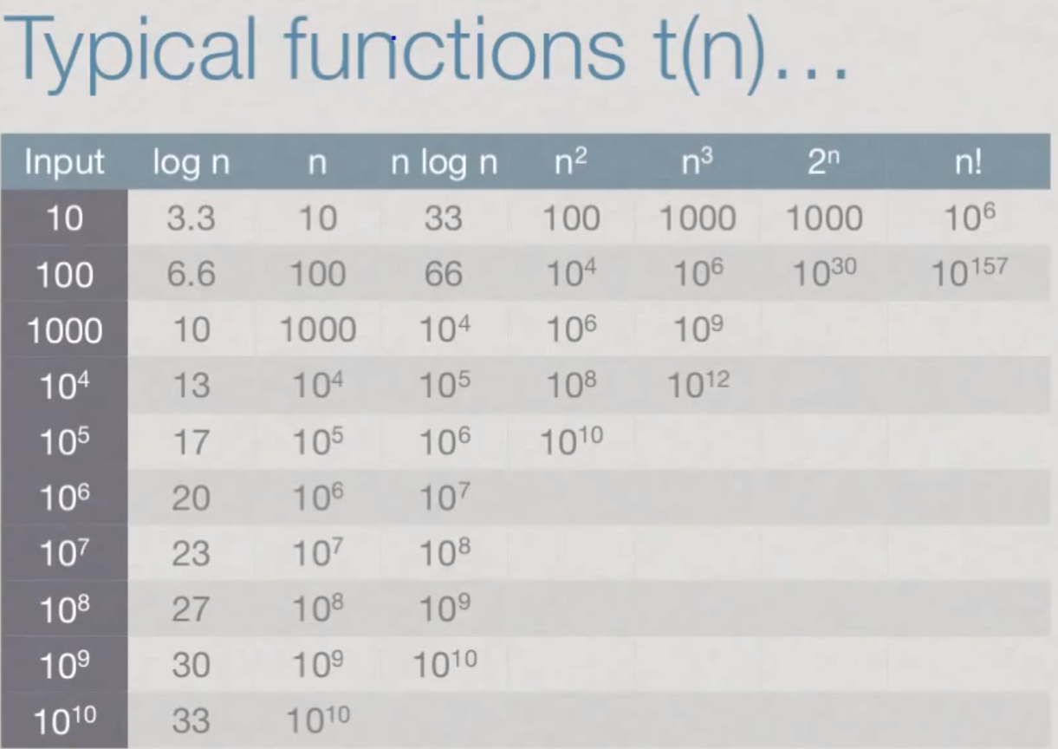

Slide 10
Let’s get started with STL

Slide 11
What is STL and why to use it?
> These are some addon classes (you’ll learn tomorrow) with powerful functions with good time complexity and space complexity management.
> Convenient and easy way to handle data and process algorithms.
> A collection of methods / algorithms which we generally use now and then, and hate to write 100 of lines of code again and again.

Slide 12
Types of STL classes
The STL classes are called containers.
Sequential Containers Associative containers
> vector > set, multiset
> list > map, multimap
> deque > unordered_set, unordered_multiset
> queue > unordered_map, unordered_multimap
> stack

Slide 13

Oh gosh :(
There are so many….are we going to learn all these?

Slide 14
For this session, we’ll cover the basics.
> iterator
> vector
> set
> unordered_set
> map
> unordered_map

Slide 15
Iterators
> As the name says, it is used to iterate over STL containers.
> Why can’t we use a simple for loop with “int i” and iterate over the container?
>> Iterator is faster then index accessing.
>> Many STL containers doesn’t allow Random Access operations.
> Iterators are specifically made for STLs.

Slide 16
Types of iterators
There are many types of iterators. But you’ll mainly use only these types:
> Random access iterators.
> Forward iterators.
> Bidirectional iterators.
General format of declaration of iterators:
> container_type <data_type>::iterator variable name;
> vector <int>::iterator itr1;
> set <int>::iterator itr2; …...and lot more. We will see in coming slides.

Slide 17

Okay man, that’s enough of this “iterator” shit!
Show me how to use it.

Slide 18

Chill bro!
It’s no fun unless Goku turns Super Saiyan :p
So, let’s start with vectors and you’ll automatically see iterator’s use.

Slide 19
Vector
> Vectors are same as dynamic arrays with the ability to resize itself automatically when an element is inserted or deleted, with their storage being handled automatically by the container.
> Just declare like:
vector<int> v;
vector<pair<int, int> > v;
vector<vector<int> > v;
vector<pair<vector<int>, pair<int, int> > > v;
And so on...

Slide 20
Vector: Functions
push_back() - Appends an element. Complexity - O(1) generally.
begin() – Returns an iterator pointing to the first element in the vector. Complexity - O(1)
end() – Returns an iterator pointing to the theoretical element that follows the last element in the vector. Complexity - O(1)
rbegin() – Returns a reverse iterator pointing to the last element in the vector (reverse beginning). It moves from last to first element. Complexity - O(1)
rend() – Returns a reverse iterator pointing to the theoretical element preceding the first element in the vector (considered as reverse end). Complexity - O(1)
size() – Returns the number of elements in the vector. Complexity - O(1)
resize() – Resizes the container so that it contains ‘g’ elements. Complexity - O(n)
empty() – Returns whether the container is empty. Complexity - O(1)
erase() - Erases an element from the container (through value or iterator). Complexity - O(n)
clear() - Clears the entire container. Complexity - O(n)

Slide 21

vector<vector< int>>

Slide 22
Let’s guess the working of this code:
https://ideone.com/QC0BGN

Slide 23
Solve some examples
> Input 10 integers and store them in a vector. Access them using an iterator, reverse them, sort them, print every time.
> Use pairs in a vector and access them.
> Try using vector<vector<int> > v;

Slide 24
Pair
> Before learning “set “and “map”, you should be aware of “pair”.
> Pair is a collection of multiple data at one place.
> Declaration:
pair<int, int> my_pair;
pair<char, int> my_pair;
pair<int, char> my_pair;
pair<string, int> my_pair;
pair<int, pair<int, int>> my_pair; And so on.

Slide 25
Let’s see a simple code for explanation.
Q. Given 5 student ID’s and their marks. Store them together and print them.
With array: https://ideone.com/ZOFQts
With pair: https://ideone.com/1mbvlv
> This is a very minimal and most basic example. But pair is used very extensively and heavily in Competitive coding as well as in Open source.

Slide 26
What’s the difference?
> You can store all the data having some relation, together at one place.
> Prevents the confusion of creating many variables.
> Easy to manipulate.
> Creates a kind of binding between the datas.
Profitable use:
Q. Sort the marks in increasing order, and now tell their respective ID’s.
Tough to maintain the ID array when sorting marks array, eh?
Naah…we’ll see how to do this with pair after some time when we see a magical “sort” function and with set!

Slide 27
Set
> Set is a tree based container which always remain sorted after any operation.
> Duplicate values are not allowed.
> Can’t modify values.
> Can’t access elements through index.
> Doesn’t support Random Access iterators.
> Insertion, *deletion, searching - O(log n)
Declaration:
> set<int> my_set;
> set<char> my_set;
> set<string> my_set; And so on….

Slide 28
Let’s guess the working of this code:
> https://ideone.com/SZt6YR - Basic I/O in set. Guess the output.

Slide 29
> Let’s code some more functions in set: size(), clear(), lower_bound(), upper_bound(), empty(), find(), erase() with iterator position and with value auto keyword, comparator and their time complexity compared to vector - Hands-on.
> How to update a value in set?
> Remember that sorting question from pair slide? Let’s do it with set :)
> So, you had said that we can’t access set elements through index, right?
Then to find the last element, we have to iterate to the end everytime?
> Nope. there’s something called Reverse iterator. Let’s do the code and see.
> Nice, but you have some restrictions. You can’t provide reverse iterator in erase function, any many more.

Slide 30

That’s all fine, but we can’t store duplicate values :(

Slide 31

Try exploring multiset.

Slide 32
unordered_set
> Generally used for searching. Constant search time. O(1). Basically a Hash table.
> Elements are not sorted (main difference between set and unordered_set).
> To check if a value is already present.
> As the name says, it’s unordered!! The elements are not stored in the order that you have inserted it in.
Let’s tackle a question to see its application and benefit.
Q. Input an array of 10 numbers, and for every inserted number, tell the number of times it has been inserted before.

Slide 33
Limitations
Same as set:
> Duplicate values are not allowed.
> Can’t modify values.
> Can’t access elements through index.
> Doesn’t support Random Access iterators.

Slide 34

Oh no...not again!
Unordered_set can’t store duplicate values.

Slide 35

Try exploring unordered_multiset!

Slide 36
So, now since you guys know about vector, set and their functions and how to calculate Time complexity, the main thing is to realise when to use what!
Let’s solve a problem.
Q. Given 10^6 numbers. Store all the numbers and clear the container by erasing all the elements one by one.
> Which container will you select for this operation? Why? And what will be its time complexity?

Slide 37
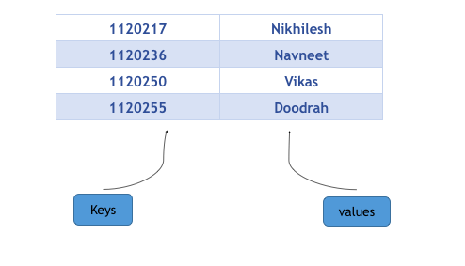
Maps
> Stores a “pair” as “key” and “value”.
> It’s also a tree data structure like set.

Slide 38
Features:
> It’s generally used for queries.
> Sorts the data according to keys.
> Keys can’t be updated, but the values can.
> Insertion, *deletion and searching - O(log n)
> Declaration format:
>> map <int, int> mymap;
>> map <string, int> mymap;
>> map <char, char> mymap;
>> map <char, vector < int> > mymap;

Slide 39
Functions in map
> All the functions are mostly similar to set, as they have similar internal data structure.
However let’s see a simple example through code to see its format for insertion, search, etc.
Q. Given an initial array of 10 elements, sort them, then iterate over the sorted array and print the initial position of each element.

Slide 40

WTF???? Not again!
Map can’t store duplicate keys. However, it can store duplicate values.

Slide 41

Try exploring multimap!

Slide 42
unordered_map
> Generally used for very fast search queries.
> Used most of the times when you don’t need the keys in sorted order. You just want to query values.
> Basically the keys are hashed.
> Constant search time. Amortized constant O(1).
> Profitable over map as the (log n) factor is removed which is used for keeping the keys sorted.
> Note: You can’t update a key. However, values can be updated.

Slide 43
I don’t think I need to say again what’s prohibited in unordered_map :p
If someone still wonders, you can refer back to the ending slide of map.

Slide 44
Tired of writing lengthy codes for sorting?
sort();
There are lots of other exciting functions in the header file “algorithm.h”
Search it on google and you’ll get nice documentations.

Slide 45
Any Questions?

Slide 46
Resources
> If you need to know / learn anything about STL containers, Google the container / function name. Always refer to cpluscplus.com or cppreference.com there. They have superb documentation (the best I’ve seen so far).
> For getting started and being acquainted with STLs, or in-depth knowledge, you can refer this video lecture series: STL by Bo Qian

Slide 47
STL does not end here.
This wouldn’t be even 5% of its “real” and actual use.
You’ve got the basics, you’ve got the resources, if you’re interested, explore and experiment!

